Slide 1


Slide 2
Myth-Busting PWAs
Toi B. Wright
Microsoft MVP (ASP.NET)
Notes:
As web developers, we have used JavaScript /HTML to develop fantastic apps of all kinds, but until recently there has been a divide between what can be done with a web app and a native app. A new class of apps called Progressive Web Apps (PWAs) is helping bridge that gap by enabling extremely native-like features in our Web Apps: offline functionality, background activity, native API layers, push notifications and even app store listings. I will show you how to can take code meant for the browser, and extend it to become cross-platform, Progressive Web Apps.

Slide 3
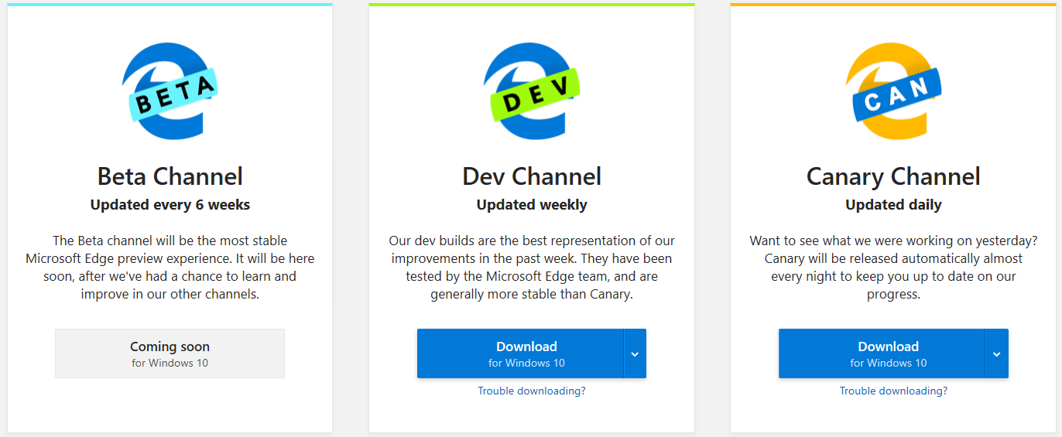
Microsoft Edge Insider Channels
https://www.microsoftedgeinsider.com
Notes:
Back in December, Microsoft announced their plan to adopt the Chromium open source project in the development of Microsoft Edge.
Create better web compatibility for their customers
Less fragmentation of the web for all web developers
Show Flags, edge://flags

Slide 4
Promises
https://developer.mozilla.org/en-US/docs/Web/JavaScript/Guide/Using_promises
Notes:
A Promise is an object representing the eventual completion or failure of an asynchronous operation. Essentially, a promise is a returned object to which you attach callbacks, instead of passing callbacks into a function.
A promise can only succeed or fail once. It does not repeat its actions. Also, it remembers its state. A promise is either pending, fulfilled or rejected.
Required from callback
Return a Value
Return a Promise
Throw an Error

Slide 5
Promise Syntax
new Promise( /* executor */ function(resolve, reject) { ... } );
executor
A function that is passed with the arguments resolve and reject. The resolve and reject functions, when called, resolve or reject the promise, respectively. The executor normally initiates some asynchronous work, and then, once that completes, either calls the resolve function to resolve the promise or else rejects it if an error occurred. If an error is thrown in the executor function, the promise is rejected.
https://developer.mozilla.org/en-US/docs/Web/JavaScript/Guide/Using_promises

Slide 6
Promises
function successCallback(result) {
console.log("Audio file ready at URL: " + result);
}
function failureCallback(error) {
console.log("Error generating audio file: " + error);
}
Old Way w/o Promises
createAudioFileAsync(audioSettings, successCallback, failureCallback);
New Way w/ Promises
createAudioFileAsync(audioSettings).then(successCallback, failureCallback);
https:/developer.mozilla.org/en-US/docs/Web/JavaScript/Guide/Using_promises
Notes:
A promise can only succeed or fail once. It does not repeat its actions.
Required from callback:
Return a Value
Return a Promise
Throws an Error

Slide 7
Promise Chain
doSomething(function(result) {
doSomethingElse(result, function(newResult) {
doThirdThing(newResult, function(finalResult) {
console.log('Got the final result: ' + finalResult);
}, failureCallback);
}, failureCallback);
}, failureCallback);
doSomething().then(function(result) {
return doSomethingElse(result);
})
.then(function(newResult) {
return doThirdThing(newResult);
})
.then(function(finalResult) {
console.log('Got the final result: ' + finalResult);
})
.catch(failureCallback);
https:/developer.mozilla.org/en-US/docs/Web/JavaScript/Guide/Using_promises
Notes:
Chaining
A common need is to execute two or more asynchronous operations back to back, where each subsequent operation starts when the previous operation succeeds, with the result from the previous step. We accomplish this by creating a promise chain.

Slide 8
Fetch API
https://developer.mozilla.org/en-US/docs/Web/API/Fetch_API
Notes:
Fetch API
The Fetch API provides a global fetch() method to fetch resources asynchronously across the network. The fetch() method takes a Request object as its parameter and returns a promise that resolves to a Response object.
The fetch specification differs from jQuery.ajax() in two main ways:
The Promise returned from fetch() won’t reject on HTTP error status even if the response is an HTTP 404 or 500. Instead, it will resolve normally (with ok status set to false), and it will only reject on network failure or if anything prevented the request from completing.
By default, fetch won't send or receive any cookies from the server, resulting in unauthenticated requests if the site relies on maintaining a user session (to send cookies, the credentials init option must be set).

Slide 9
fetch() Syntax
fetch(input[, init]);
input
Request object
init (optional)
Options object containing custom settings that you want to apply to the request
fetch('http://example.com/contacts')
https://developer.mozilla.org/en-US/docs/Web/API/Fetch_API

Slide 10
Sample Fetch
var myHeaders = new Headers();
myHeaders.append("Content-Type", "application/json");
var myInit = { method: 'GET',
headers: myHeaders,
mode: 'cors' };
var myRequest = new Request('https://devfestservice.azurewebsites.net/api/speakers/1');
fetch('https://devfestservice.azurewebsites.net/api/speakers/1')
.then(function(response) { return response.json(); })
.then(function(myJson) { console.log(myJson); })
.catch(function(error) {console.log(error.message); });
https://developer.mozilla.org/en-US/docs/Web/API/Fetch_API

Slide 11
Init Options
method
headers
body
mode
credentials
cache
redirect
referrer
referrerPolicy
Integrity
keepalive
signal
https://developer.mozilla.org/en-US/docs/Web/API/Fetch_API
Notes:
An options object containing any custom settings that you want to apply to the request.
method: the request method, e.g., GET, POST.
headers: Any headers you want to add to your request, contained within a Headers object or an object literal with ByteString values.
body: Any body that you want to add to your request: this can be a Blob, BufferSource, FormData, URLSearchParams, or USVString object. Note that a request using the GET or HEAD method cannot have a body.
mode: The mode you want to use for the request, e.g., cors, no-cors, or same-origin.
credentials: The request credentials you want to use for the request: omit, same-origin, or include. To automatically send cookies for the current domain, this option must be provided. Starting with Chrome 50, this property also takes a FederatedCredential instance or a PasswordCredential instance.
cache: The cache mode you want to use for the request: default, no-store, reload, no-cache, force-cache, or only-if-cached.
redirect: The redirect mode to use: follow (automatically follow redirects), error (abort with an error if a redirect occurs), or manual (handle redirects manually). In Chrome the default is follow (before Chrome 47 it defaulted to manual).
referrer: A USVString specifying no-referrer, client, or a URL. The default is client.
referrerPolicy: Specifies the value of the referer HTTP header. May be one of no-referrer, no-referrer-when-downgrade, origin, origin-when-cross-origin, unsafe-url.
integrity: Contains the subresource integrity value of the request (e.g., sha256-BpfBw7ivV8q2jLiT13fxDYAe2tJllusRSZ273h2nFSE=).
keepalive: The keepalive option can be used to allow the request to outlive the page. Fetch with the keepalive flag is a replacement for the Navigator.sendBeacon() API.
signal: An AbortSignal object instance; allows you to communicate with a fetch request and abort it if desired via an AbortController.

Slide 12
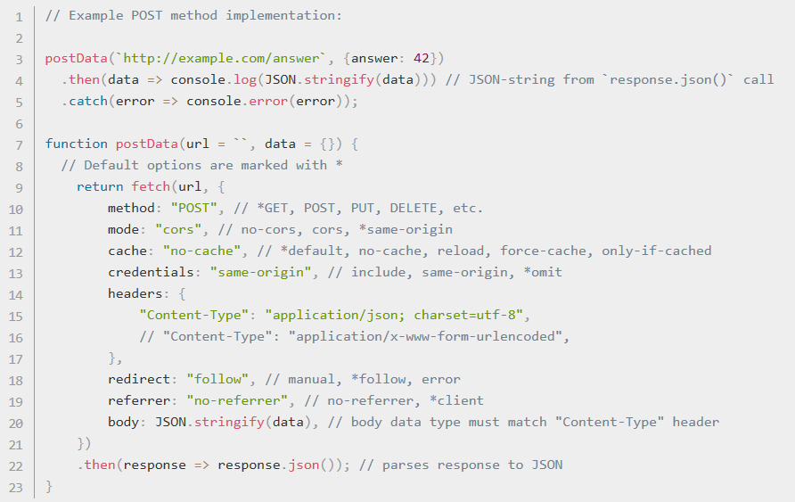
https://developer.mozilla.org/en-US/docs/Web/API/Fetch_API

Slide 13
Cache API
https://developer.mozilla.org/en-US/docs/Web/API/Cache
Notes:
The Cache interface provides a storage mechanism for Request / Response object pairs that are cached
Items in the cache do not expire. You are also responsible for periodically purging cache entries.
Make sure you version your cache.
The caching API doesn't honor HTTP caching headers.

Slide 14
cache.put() Syntax
Promise<void> cache.put(request, response)
.then(function() {
// request/response pair added to cache
});
request
Request object
response
Response object
https://developer.mozilla.org/en-US/docs/Web/API/Cache
Notes:
Takes both a request and its response and adds it to the given cache.

Slide 15
Cache Methods
Cache.put(request, response)
Cache.match(request, {options})
Cache.keys(request, {options})
Cache.delete(request, {options})
Cache.add(request)
Cache.addAll(url[])
https://developer.mozilla.org/en-US/docs/Web/API/Cache
Notes:
Cache.put(request, response) Takes both a request and its response and adds it to the given cache.
Cache.match(request, options) Returns a Promise that resolves to the response associated with the first matching request in the Cache object.
Cache.keys(request, options) Returns a Promise that resolves to an array of Cache keys.
Cache.delete(request, options) Finds the Cache entry whose key is the request, returning a Promise that resolves to true if a matching Cache entry is found and deleted. If no Cache entry is found, the promise resolves to false.
Cache.add(request) Takes a URL, retrieves it and adds the resulting response object to the given cache. This is functionally equivalent to calling fetch(), then using put() to add the results to the cache.
Additional methods
Cache.matchAll(request, options) Returns a Promise that resolves to an array of all matching requests in the Cache object.
Cache.addAll(requests) Takes an array of URLs, retrieves them, and adds the resulting response objects to the given cache.
Options: ignoreSearch, ignoreMethod, ignoreVary, cacheName

Slide 16











A PWA is
Progressive
Works on any device and enhance functionality progressively.
Performant
Works as fast or faster than a native app.
Linkable
Ability to retain or reload its state and be shareable from a link.
Responsive
Fit any device’s form factor and screen size.
App-like
Looks like a native app and uses the application shell model with minimal page refreshes.
Connectivity-agnostic
Works with low connectivity or offline.
Installable
Install on the device’s desktop, start menu, or task bar making it readily available.
App-like
Connectivity-agnostic
Progressive
Re-engageable
Promotes re-engagement through features such as push notifications.
Discoverable
Better discovery and integration with search.
Connected to users
Direct feedback to you through ratings and reviews
Current
Application and content is up to date when connected to the Internet.
Notes:
A Progressive Web App (PWA) is a web app that uses modern web capabilities to deliver an app-like experience to users. It looks and feels like a native application.
App-Like
Connectivity-agnostic
Installable
Progressive - can take advantage of features when they are available, but it does not break down when they don’t exist. Web apps that are progressively enhanced with native app-like features.

Slide 17



CROSS PLATFORM
X
PROGRESSIVE
WEB APPS
Devices + IoT
PC
Xbox
Surface Hub
HoloLens
ACROSS WINDOWS
Notes:
What is a PWA? It’s a web app that looks and feels like a native app.
Sample PWAs: https://pwa.rocks/

Slide 18
A Minimum Viable PWA
HTTPS
Web App Manifest
Service
Worker
Let’s Encrypt, https://letsencrypt.org/ , is a free, automated, and open Certificate Authority
Notes:
Web App Manifest
A manifest is a JSON document that contains startup parameters and application defaults for when a web application is launched.
Service Worker
A service worker is an event-driven worker registered against an origin and a path. It takes the form of a JavaScript file that can control the web page/site it is associated with, intercepting and modifying navigation and resource requests, and caching resources in a very granular fashion to give you complete control over how your app behaves in certain situations, (the most obvious one being when the network is not available.)
A service worker is run in a worker context: it therefore has no DOM access, and runs on a different thread to the main JavaScript that powers your app, so it is not blocking. It is designed to be fully async; as a consequence, APIs such as synchronous XHR and localStorage can't be used inside a service worker.

Slide 19
Web App Manifest
{
"short_name": "Wash Post",
"name": "The Washington Post",
"icons": [
{
"src": "img/launcher-icon-2x.png",
"sizes": "96x96",
"type": "image/png"
},
{
"src": "img/launcher-icon-4x.png",
"sizes": ”512x512",
"type": "image/png"
}
],
"start_url": "/pwa/?utm_source=homescreen",
"display": "standalone",
"orientation": "portrait",
"background_color": "black“,
"lang": "en"
}
Identity
Icons
Presentation
Miscellaneous

Slide 20
Myth 1: PWAs need to be built from scratch

Slide 21
Demo
PWA Builder to the rescue!
Notes:
URL: https://idt19.azurewebsites.net/
PWA Builder
https://www.pwabuilder.com
Open source project driven by Microsoft to help you build a PWA from an existing web app: manifest, visual assets & service workers
Manifest
Update Name and Description
Upload an image
Service Worker
Choose the service worker based on the functionality that you want.
Offline page
Cache-first network

Slide 22

Myth 1: PWA needs to be built from scratch
All the PWA core technology is designed to be layered on top of your current web app
PWAs do not need to use any particular framework or be a single page application (SPA)
Don’t start from scratch if you already have a high-quality web app!

Slide 23
Myth 2: PWAs have limited performance

Slide 24
WebAssembly
Provides a way to run code written in multiple languages, such as C#, on the web at near native speed
Human-readable text format that allows code to be written, viewed and debugged by hand
Runs in a safe, sandboxed execution environment
Designed to run alongside JavaScript, allowing both to work together.
W3C WebAssembly Working Group: https://www.w3.org/wasm/
Notes:
WebAssembly is a way of taking code written in programming languages other than JavaScript and running that code in the browser.
Goals
WebAssembly is being created as an open standard inside the W3C WebAssembly Community Group with the following goals:
• Be fast, efficient, and portable — WebAssembly code can be executed at near-native speed across different platforms by taking advantage of common hardware capabilities.
• Be readable and debuggable — WebAssembly is a low-level assembly language, but it does have a human-readable text format (the specification for which is still being finalized) that allows code to be written, viewed, and debugged by hand.
• Keep secure — WebAssembly is specified to be run in a safe, sandboxed execution environment. Like other web code, it will enforce the browser's same-origin and permissions policies.
• Don't break the web — WebAssembly is designed so that it plays nicely with other web technologies and maintains backwards compatibility.

Slide 25
Demo
To JavaScript and Beyond!
Notes:
WebSight is a face detection app. It compares the performance between JavaScript, asm.js, and WebAssembly.
FPS: frames per second
URL: https://david.blob.core.windows.net/idt2019/wasm/index-video.html

Slide 26
Myth 2: PWAs have limited performance
JavaScript performance continues to improve and meets the needs of most applications
For native performance use WebAssembly

Slide 27
Myth 3: I’ll miss XAML

Slide 28
Web Components
A family of web standards used to build components that act, look and perform like native page elements.
Encapsulate your markup, CSS and JavaScript to make sure the work on any page or with any framework
Strong support across browsers, but great libraries available like stencil, lit-element, and x-tag that handle Pollyfilling
Notes:
Web Components enable component-based markup across frameworks

Slide 29

Web component
<script>
customElements.define('x-new-markup', class extends HTMLElement {
connectedCallback() {
this.innerHTML = "<b>Hello, welcome to the </b>";
}
});
</script>
<x-new-markup>Insider Dev Tour</x-new-markup>

Slide 30
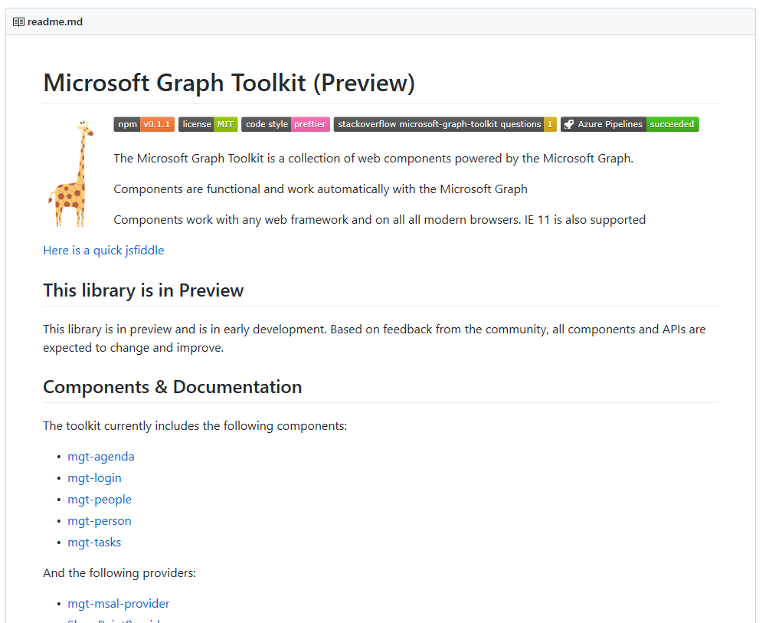
Try the Microsoft Graph Toolkit today

Slide 31
Demo
Add the graph toolkit to your PWA
Notes:
URL: https://github.com/microsoftgraph/microsoft-graph-toolkit

Slide 32
Myth 3: I’ll miss XAML
Web components provide the component style UI that you are used to from XAML development
Use the Microsoft Graph Toolkit to have a line-of-code helper for easy login and much more!
https://github.com/microsoftgraph/microsoft-graph-toolkit

Slide 33
Myth 4, 5 & 6: PWAs can’t reach all my users

Slide 34


Web Applications: Journey
Windows Web Applications
Hosted Web Applications
Progressive Web Applications
Capabilities via WinRT
Web Standards
1
Windows Web Application Host
2
Browser-based Host
✔
❌
Store +
Browser
Store
Browser
3
Notes:
We started our Web Application journey in Windows 10, with Windows Web Applications.
Over the years, we evolved it to support what we called Hosted Web Apps and Progressive Web Apps.
These apps accessed native capabilities using WinRT APIs.
They run in Windows Web Application Host.
And they acquired from the Microsoft Store but not from a browser.
These models did create some friction:
Using WinRT APIs meant these apps could not be cross-platform.
The host supported inconsistent set of functionality vs. the browser.
Finally, your apps had limited discoverability.

Slide 35
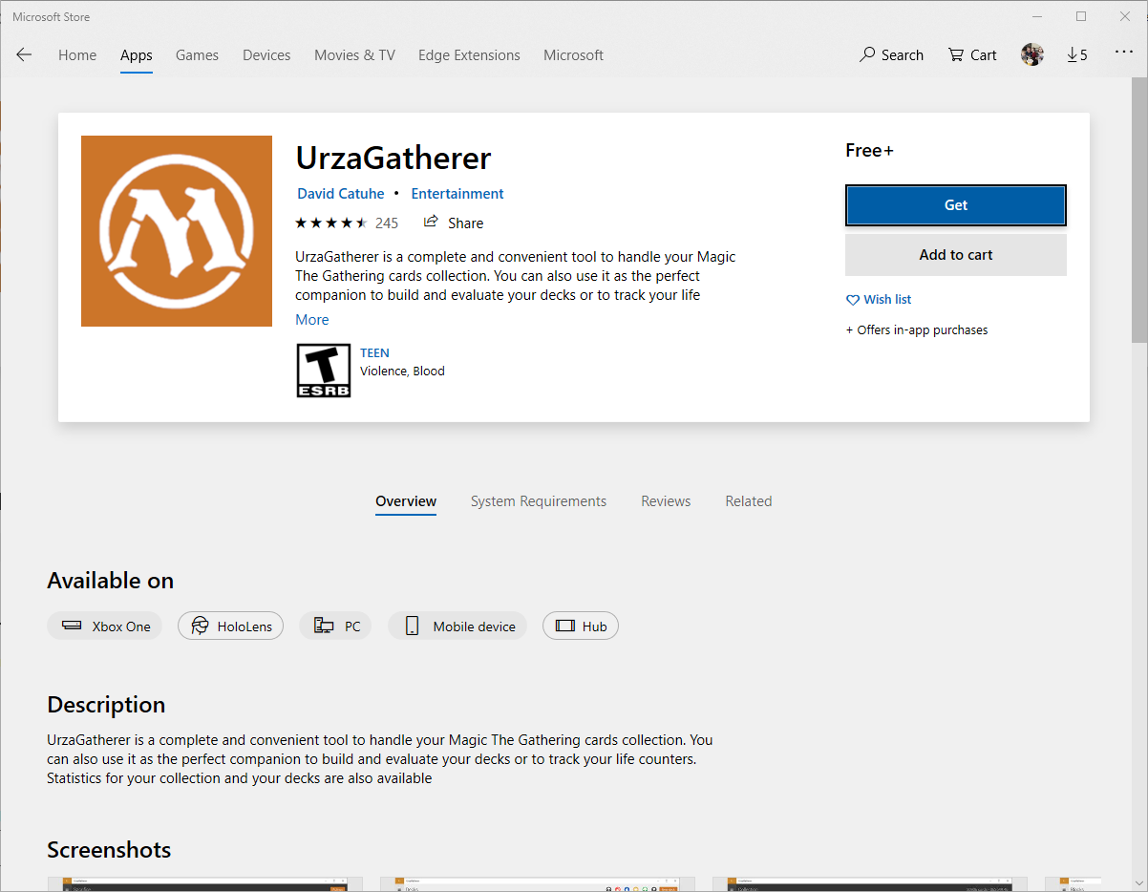
Notes:
Explain that the developer, who is a PWA Builder user, has switched from a native app to PWA to reach more users. Show the reviews are still excellent. This is another acquisition channel that could even be monetized in a different way. You have also all the services provided by the store platform like a better engagement with your users.

Slide 36
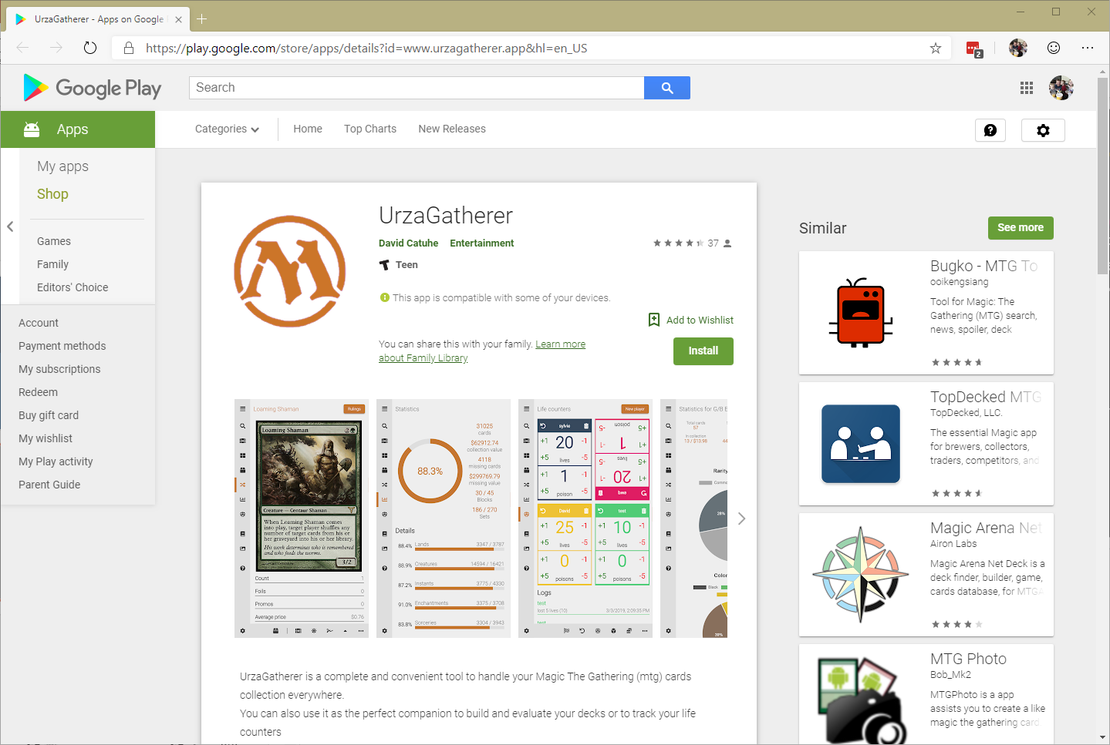
Notes:
Explain this is still the same PWA coming from the same webserver. Updating the PWA on your server will be reflected in the installed desktop PWA directly from Edge, from the MS Store or from the Play Store. One code to rule them all!

Slide 37

Web Applications: Journey
Windows Web Applications
Hosted Web Applications
Progressive Web Applications
Capabilities via WinRT
Web Standards
1
Windows Web Application Host
Browser-based Host
2
Store +
Browser
Store
3
❌
Browser
Notes:
With new Edge, we are taking the next step in our journey by bringing support for standards based cross-platform web applications.
These Progressive Web Apps will:
Access capabilities via web-standards
Run in a browser-based host
Will be discoverable and installable from the browser

Slide 38
Demo
What we’re working on for the future
Notes:
URL: www.urzagatherer.app
The developer used PWA Builder and switch from a native app to PWA to reach more users. The reviews are still excellent.

Slide 39
Myth 4, 5 & 6: PWAs can’t reach all my users
Go to PWABuilder.com to get store packages for every platform. Next version of Edge is coming in the future.
Web discovery helps you convert your existing Web users to more highly engaged PWA users.
Notes:
Partly busted as we’re working on the new Edge

Slide 40
Myth 7: PWAs look like web pages

Slide 41
Demo
Creating a beautiful app is a matter of skills, not technologies.
Notes:
Contoso Home
https://fluentweb.netlify.com/

Slide 42
Myth 7: PWAs look like web pages
Latest CSS & JavaScript specifications enable you to create fast, beautiful & responsive UI/UX: Grid Layout, Flexbox, CSS Filters, CSS Paint API (aka Houdini), WebGL, and so on
You can embrace the design language of the targeted platform if needed

Slide 43
Myth 8: PWAs can’t run in the background

Slide 44
Demo
Even closed, the PWA is still ready to help.
Notes:
Northwind PWA
https://northwindpwa.azurewebsites.net
Open and install PWA Chat
Close the chat
Click Contact Customer
Explain to the audience that a background task is always monitoring push notifications and can open back an installed PWA, like any other native app
Each platform has their own Push Service.

Slide 45
Myth 8: PWAs can’t run in the background
Using Service Workers, you can subscribe to a push notification services that will call you back using WNS in Edge (Windows Notification Services) as well as other push services for different browsers

Slide 46
Myth 9: Interfacing with desktop hardware requires a native app

Slide 47
Connecting Hardware to PWA
Web BlueTooth: to access BT LE devices
Web USB
Web MIDI
WebVR / XR : all VR headsets & controllers
More on the way!

Slide 48
Demo
Web MIDI
Notes:
https://preview.pwabuilder.com/features
Open Feature Store
Web MIDI

Slide 49
Myth 9: Interfacing with desktop hardware requires a native app
Many hardware interfaces are available today for the Web
Future collaborations between Microsoft and Google in project Fugu will continue to enable more options within a PWA

Slide 50
Myth 10: Real brands aren’t using PWAs for consumer apps

Slide 51
Demo
PWAs are driving more businesses than you may think!
Notes:
Demo the apps if you’ve got enough time otherwise, skip to the conclusion

Slide 52




Myth 10: Real brands aren’t using PWAs for consumer apps
Notes:
Twitter, https://mobile.twitter.com
Pinterest, https://www.pinterest.com

Slide 53
aka.ms/insiderdevtour-labs
Notes:
Check out the labs and resources, including all links, here

Slide 54
More Resources
https://www.pwabuilder.com/
https://realfavicongenerator.net
https://developers.google.com/web/progressive-web-apps/checklist
https://webhint.io/
https://developers.google.com/web/tools/lighthouse

Slide 55
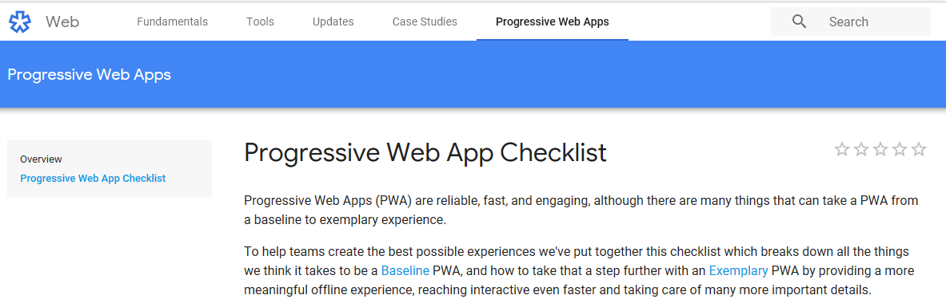
PWA Checklist
https://developers.google.com/
web/progressive-web-apps/checklist

Slide 56

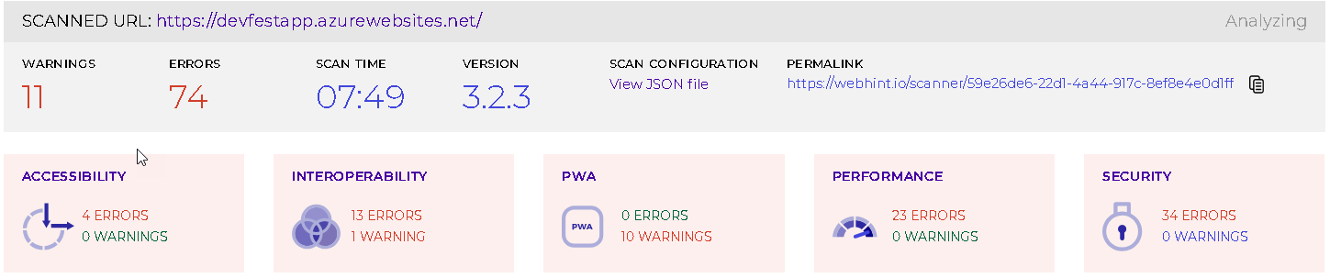
Web Hint
https://webhint.io/

Slide 57
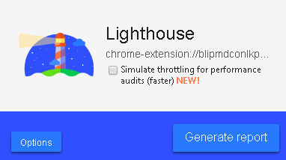
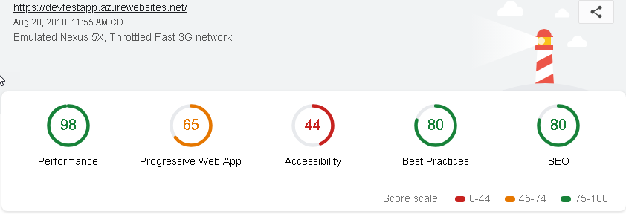
Lighthouse
https://developers.google.com/
web/tools/lighthouse/

